Slide 1
Group 3
Alex Storton, Bruce Skaar, Gagandeep Singh, Mwohania Taylor, Niti Patel, Skyler Khalachyan
Notes:
Bruce

Slide 2
Project Outline
Predict patient disease based on their symptoms, blood pressure and cholesterol readings and demographics (age, gender)
Our proposed solution: Develop a web app that runs a ML model that ingests user input parameters and produces an output that predicts whether or not a person is likely to have a disease based on their current symptoms and demographics. If the results are positive, our model would suggest that a disease is likely and that they should follow up with their provider.
Notes:
Bruce
Bruce: Good Evening. We are Group 3 and are excited to introduce our innovative project, the ‘Predictive Disease Diagnosis model’. In a world where healthcare is becoming increasingly personalized and data-driven, our solution aims to empower individuals and healthcare providers alike by harnessing the power of machine learning.
At it’s core, our project addresses a critical challenge - predicting patient diseases based on a combination of factors, including their symptoms, blood pressure and cholesterol readings, as well as demographic information such as age and gender.

Slide 3
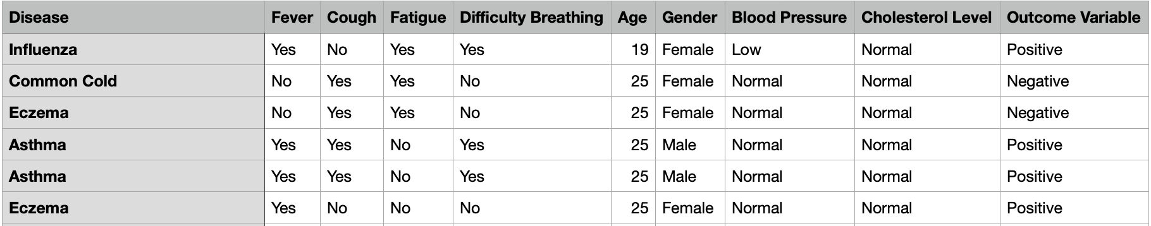
The Data: Disease Symptoms and Patient Profile.
Our data set consist of 6 columns that feature Symptoms a person is experiencing.
2 Columns for individual identity.
1 Column provides a output for the Disease an individual has per their Symptoms.
1 Column that provides either a “Positive” or “Negative” variable confirming the Disease is present or not.
Lastly, total input data is 349 Rows.
Notes:
Bruce: Now let’s take a closer look at the heart of our solution: the data that powers it.
Our data comprises 349 rows of valuable information that we’ve carefully curated. In essence, each row represents an individual, and our dataset is a snapshot of their health profile
We’ve collected a range of data points for each individual, which includes the symptoms they’re experiencing. These symptoms provide crucial insights into the potential health issues they might be facing.
Another important component of our dataset is the ‘Disease Output’ column. This column specifies the disease our model has associated with the individual’s symptoms. It’s a reference point that guides us in evaluating the accuracy of our predictions.
To validate our predictions, we’ve introduced a ‘Positive/Negative’ column. This column confirms whether the disease is actually present (‘Positive’) or not (‘Negative’). This feedback loop is essential for refining our model’s accuracy.
The data has been anonymized with only age and gender dedicated to individual identity.
I will now turn over to Gagandeep to discuss some of the visualizations of our data.

Slide 4
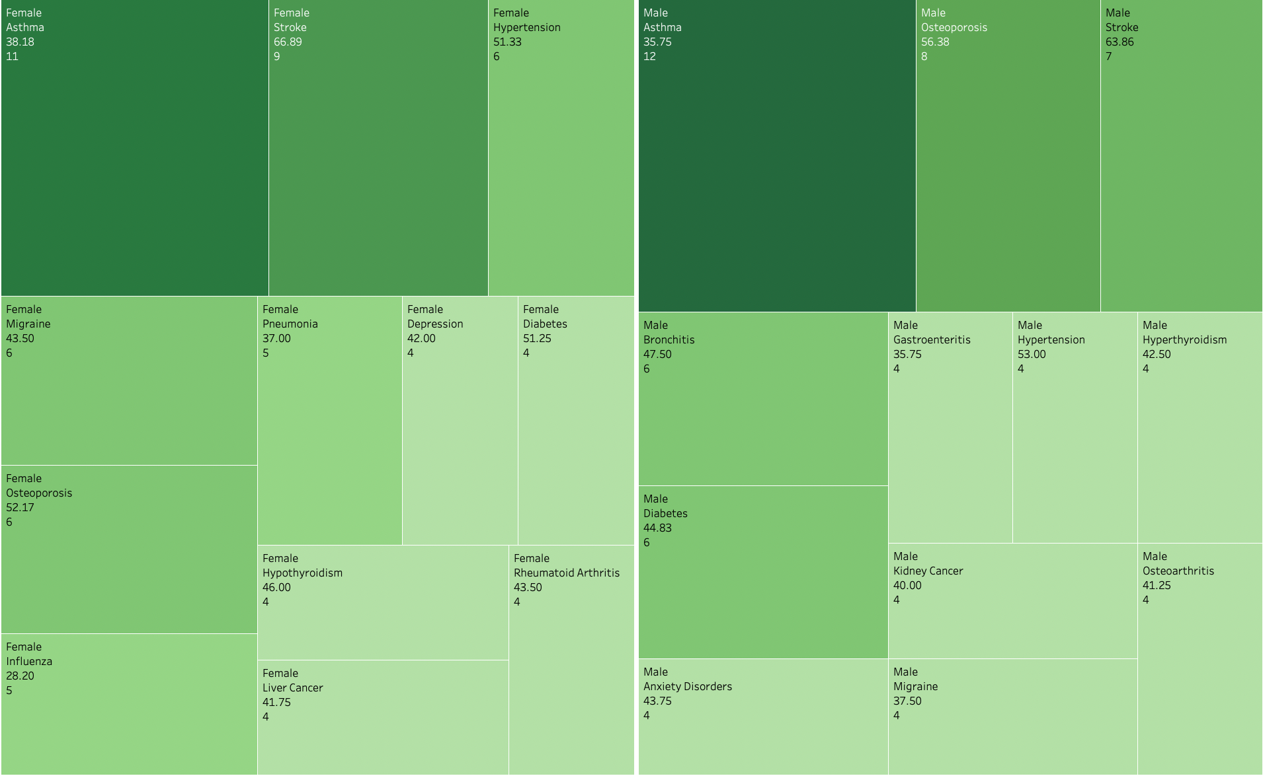
Top Female vs
Male Diseases
Legend:
Gender
Disease
Age (Average)
Disease Count
Notes:
Gagandeep
The data above shows the top 12 diseases in our dataset for Females and Males.
Some key highlights
Between both genders Asthma had the highest count of diagnosis (11 for female and 12 for male)

Slide 5
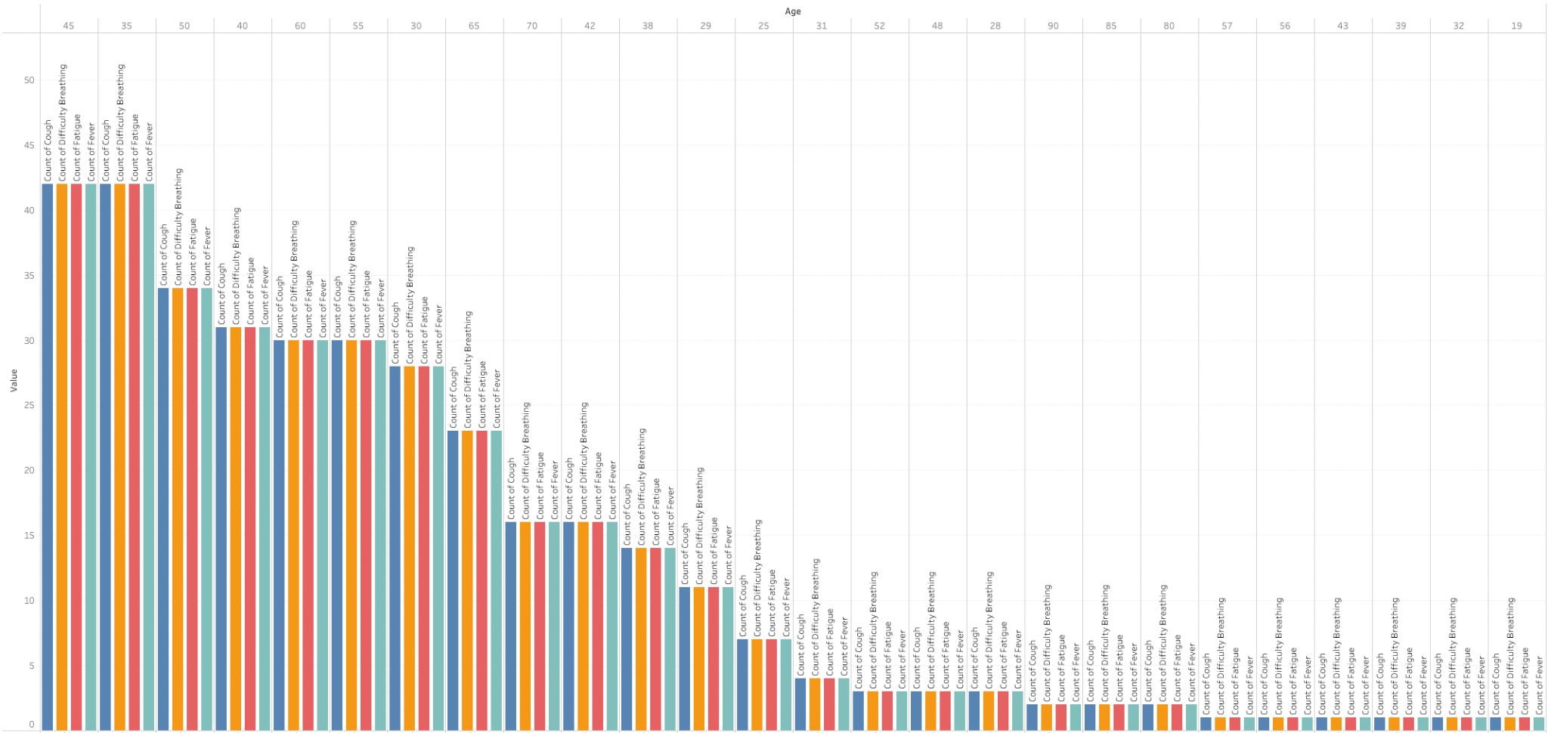
Age vs Symptoms
Notes:
Gagandeep
Here we wanted to take our symptoms inputs and see what age had the highest quantity.
Per the dataset as a individual ages they have more symptoms for anytime of disease.
For instance a 45 year old may have fever cough fatigue and difficulty breathing while a younger person may only have a cough or breathing difficulty when determining if both individuals have Asthma.
Next we have NITI

Slide 6
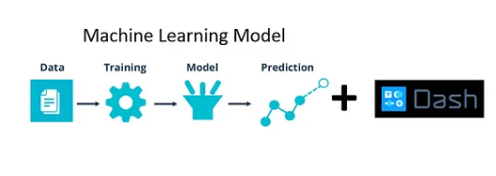
Scope of Work
Source a data set that contains a series of categorical data
Enhance a supervised classification ML model that predicts disease based upon a discrete set of values
Create a web app interface that lists the different categories from data source and executes the model
Connect the web app to the ML model
Notes:
Niti

Slide 7
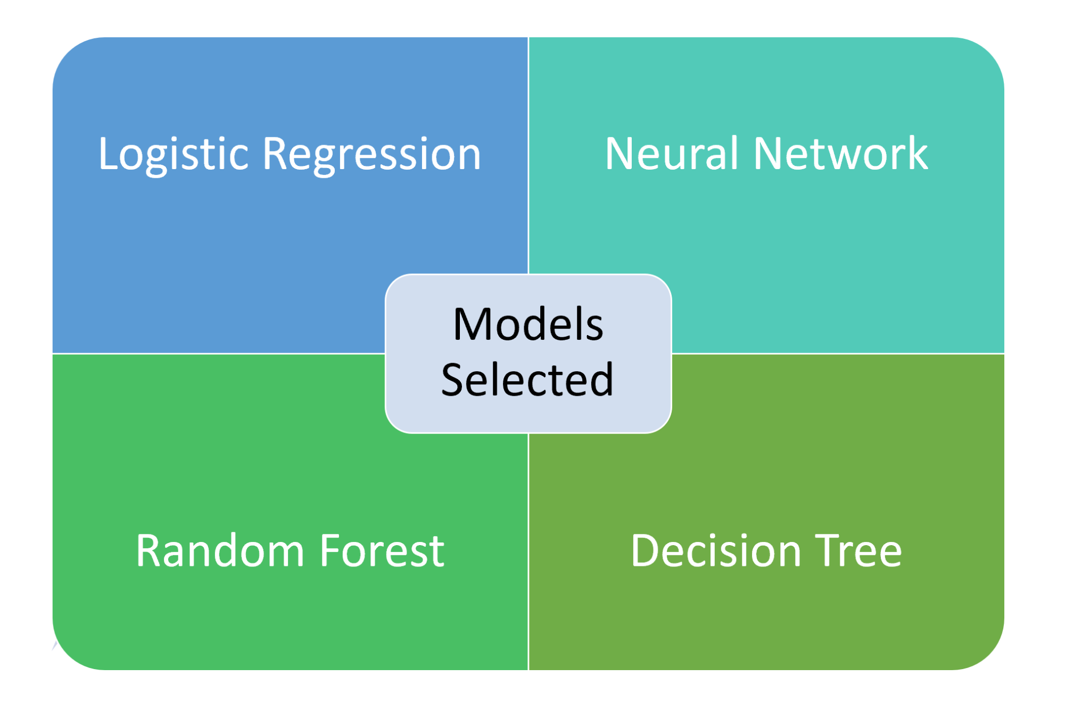
Data Model Implementation
Model Selection & Experimentation
Supervised learning models only
All use same data pre-processing code
Same target variable
Data Preparation
Label encode all categorical data
“Age” was the only feature scaled for the modeling
Notes:
Alex

Slide 8
Optimizing our Models for Success
- Logistic Regression (LR)
Final Accuracy Score: 57.6%
Iteration #3 (Final)
03
Iteration #1 (2.3%)
01
02
Iteration #2 (51%)
Notes:
Niti

Slide 9
Optimizing our Models for Success
- Neural Network (NN)
Final Accuracy Score: 65.9%
Iteration # 1 (2.1%)
04
Iteration #4 (Final)
01
03
Iteration #2 (56.8%)
Iteration #3 (64.7%)
02
Notes:
Alex

Slide 10
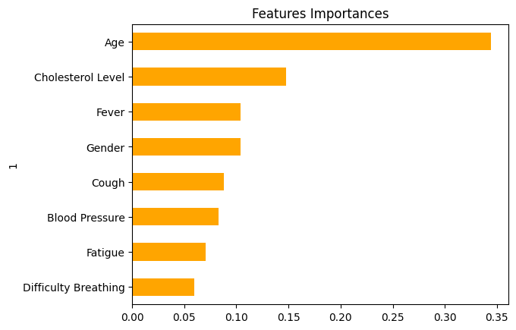
Optimizing our Models for Success
Random Forest (RF)
Final Accuracy Score: 79.5%
Only one iteration implemented
Used to help provide insights on the features themselves
Notes:
Alex

Slide 11
Optimizing our Models for Success
- Decision Tree (DT)
Final Accuracy Score: 80%
Iteration 3
80%
03
Iteration #1
17%
01
02
Iteration 2
78%
Notes:
Skyler

Slide 12
Demo
Notes:
Gagandeep

Slide 13
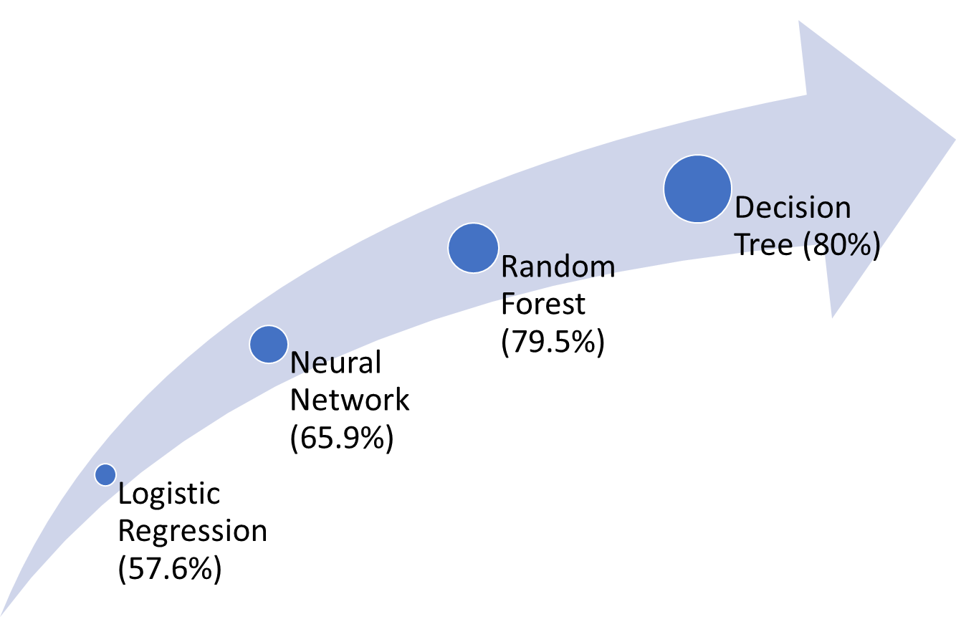
Model Development Challenges
Label encoding vs One Hot Encoder
Deciding which columns to drop
Connecting front-end to the back-end
Neural network modeling complexity with smaller data set
Notes:
Skyler/Alex

Slide 14

Future Opportunities
Having a significantly larger dataset.
Solve TensorFlow issues in running our Webapp.
Push the model(s)l to 90% accuracy threshold
Integrate Tableau visualizations into the web app
Integrate a web scraper to pull local doctors that specialize in the diseases based on user entered zip code and display summary info (contact, ratings, etc)
Notes:
Nia

Slide 15
Q&A

